Slide 1
Feature-based Methods
Topology of Vector and Scalar Fields

Slide 2
Feature-based Visualization
very important
Feature Extraction
Features:
Represent interesting structures or objects in the data
Extract and visualize them
The original (large) field is not needed anymore for visualization
Extraction can (usually) be automated
Rendering is fast and (usually) interactive
Medium to high cognitive load
Typical features:
Topological features
Vortices
Shock waves
Extremal structures

Slide 3
Flow Visualization: Visualization Methods
Topology based visualization
Idea:
extract and visualize the topological skeleton
2D stationary vector fields:
critical points
boundary switch points
separatrices
isolated closed stream lines

Slide 4
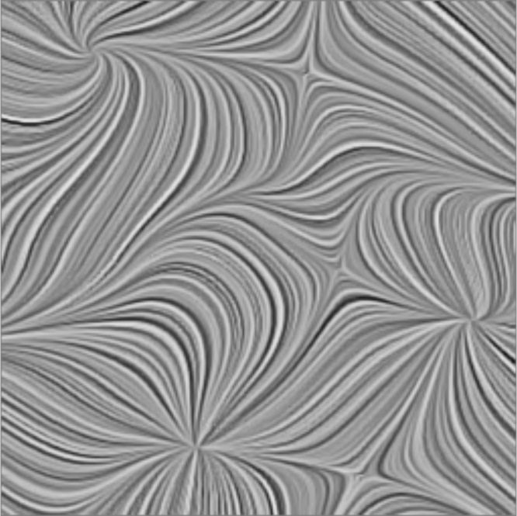
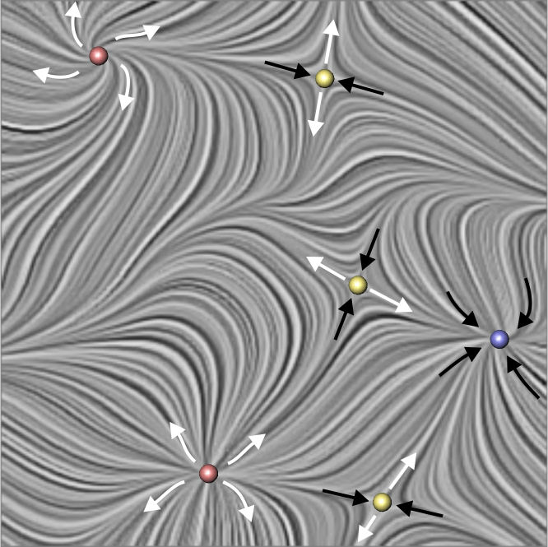
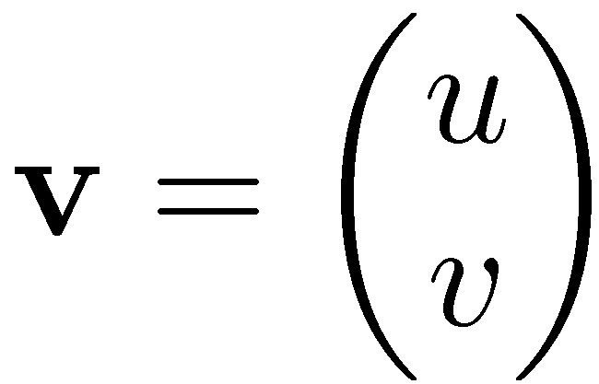
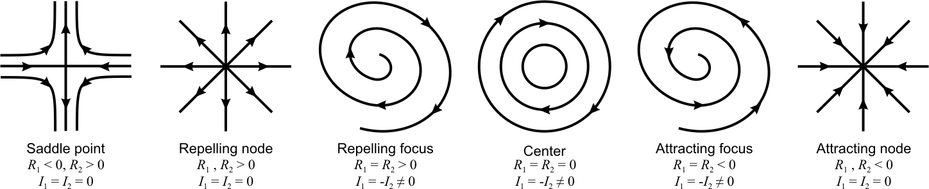
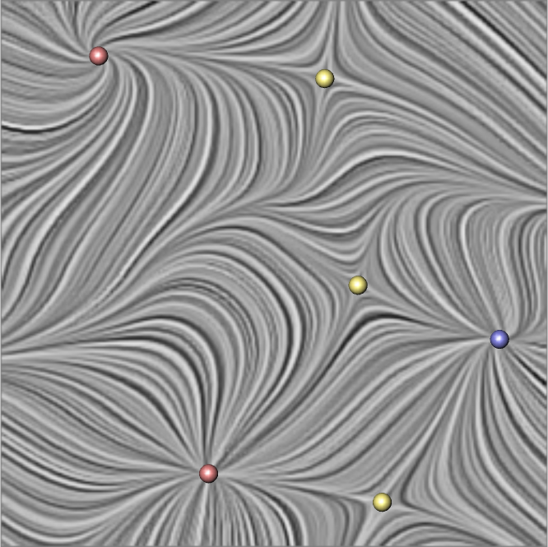
Topological Structures
steady 2D vector field
stream lines
critical points

Slide 5
Flow Visualization: Problems and Concepts
very important
First order 2D critical points
The point x₀ is a first order critical of the vector field v iff
1) x₀ is a critical point of v, and
2) det(J_{v}(x₀)) ≠ 0
The different types can be classified by the eigenvalues of the Jacobian:
R₁, R₂ ➔ real part of the eigenvalue I₁, I₂ ➔ imaginary part of the eigenvalue

Slide 6
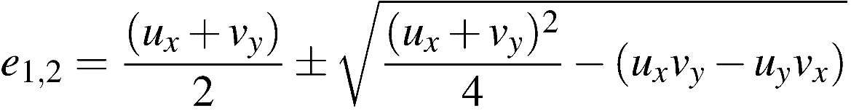
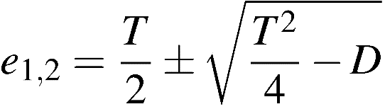
Flow Visualization: Problems and Concepts

Slide 7
Flow Visualization: Problems and Concepts
General classification of 2D critical points:
Distinguish regions of different flow behavior around a critical point. 3 cases are possible:
In a parabolic sector either all tangent curves end, or all tangent curves originate, in the critical point.
In a hyperbolic sector all tangent curves go by the critical point, except for two tangent curves making the boundaries of the sector. One of these two tangent curves ends in the critical point while the other one originates in it.
In an elliptic sector all tangent curves originate and end in the critical point.

Slide 8
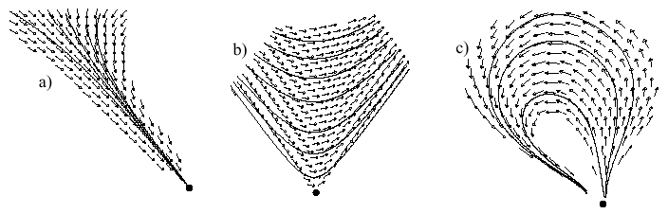
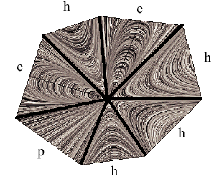
Flow Visualization: Problems and Concepts
a) parabolic sector; b) hyperbolic sector; c) elliptic sector
critical point consisting of 7 sectors

Slide 9
Flow Visualization: Problems and Concepts
Poincaré-Index of a critical point:
place small closed curve around critical point
index: number of counterclockwise rotations of the vectors of v while traveling counterclockwise on the closed curve
➔ index is an (possibly negative) integer

Slide 10
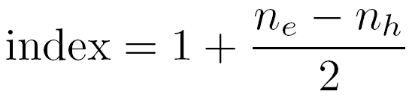
Flow Visualization: Problems and Concepts
Poincaré-Index of a critical point:
For general critical point: index can be obtained by counting different sectors:
n_{e} : number of elliptic sectors
n_{h} : number of hyperbolic sectors

Slide 11
Flow Visualization: Problems and Concepts
n_{e} : number of elliptic sectors
n_{h} : number of hyperbolic sectors
a) parabolic sector
b) hyperbolic sector
c) elliptic sector
index(saddle) = -1
index(source/sink/center) = +1

Slide 12
Flow Visualization: Problems and Concepts
Poincaré-Index of a first-order critical point:
first order critical points: have index +1 or –1
index(saddle) = -1
index(source/sink/center) = +1

Slide 13
Flow Visualization: Problems and Concepts
Index-theorem:
index(area) = Σ index(cp)
i.e., sum over all indices of the critical points in the area

Slide 14
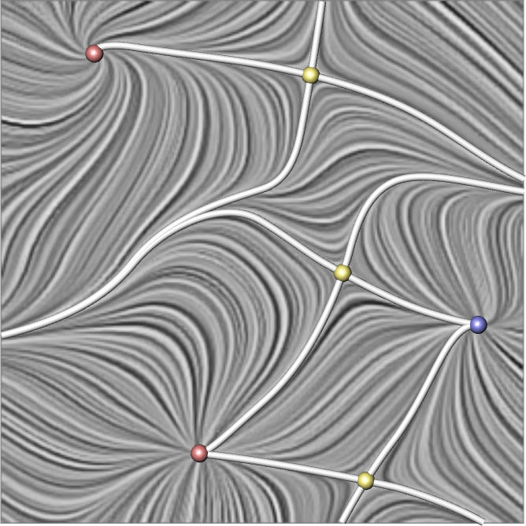
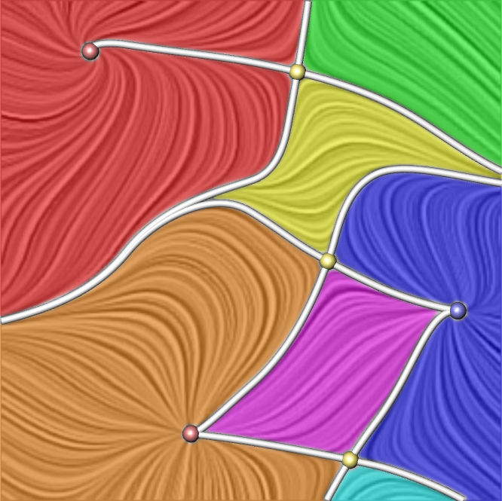
Topological Structures
steady 2D vector field
stream lines
critical points
separation lines
sectors of different flow behavior

Slide 15
Flow Visualization: Problems and Concepts
Separatrices:
Special stream lines which separates regions of different flow behavior.
Types of separatrices:
Each stream line originating/ending in a critical point and separating two sectors ➔ is a separatrix.
stream lines through boundary switch points
isolated closed stream lines

Slide 16
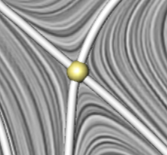
Flow Visualization: Problems and Concepts
Separatrices from first order saddle:
4, in the direction of the two eigenvectors of the Jacobian matrix

Slide 17
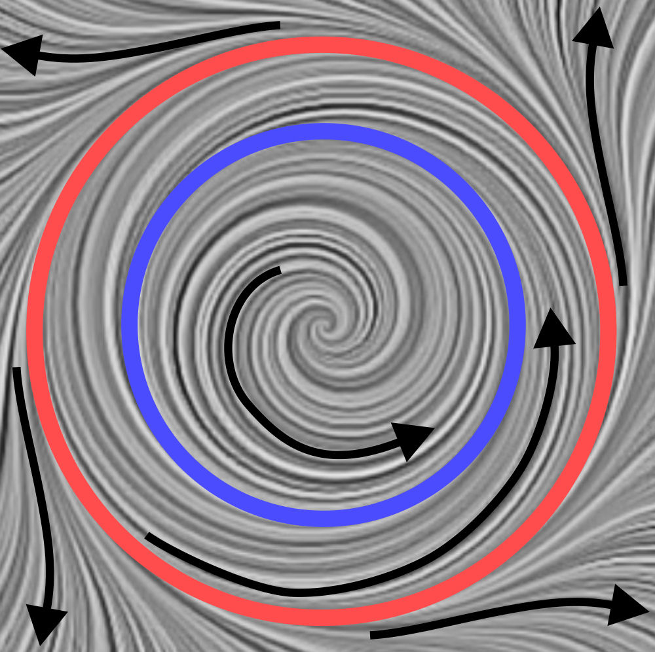
Topological Structures
closed stream lines

Slide 18
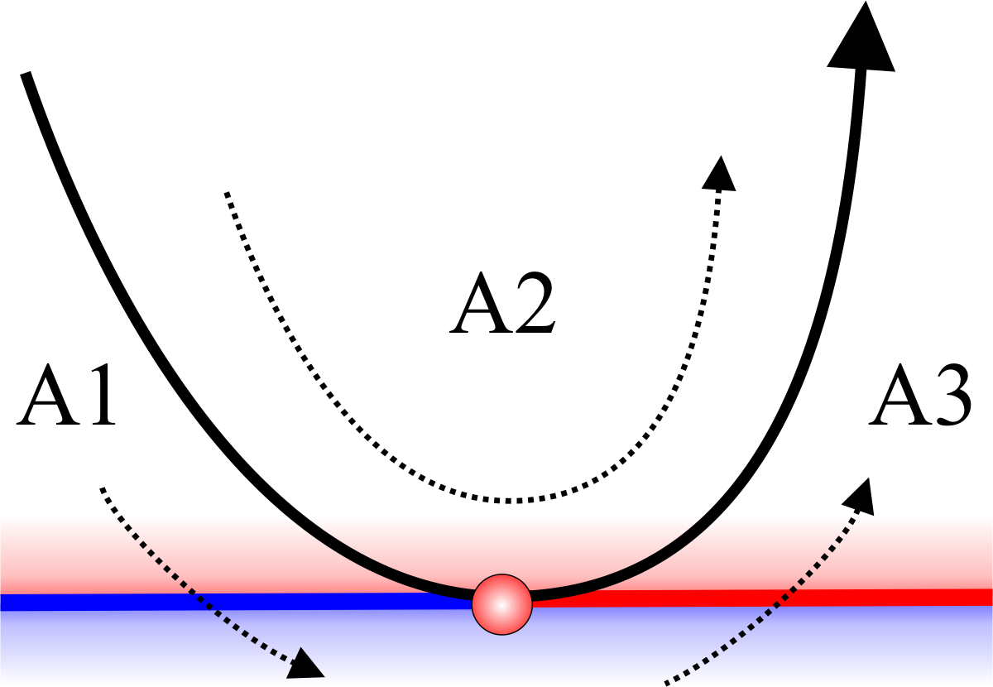
Flow Visualization: Problems and Concepts
Boundary switch points:
change inflow ⬄ outflow at boundary of the domain of v
v(x) parallel to tangent of boundary curve at boundary point x

Slide 19
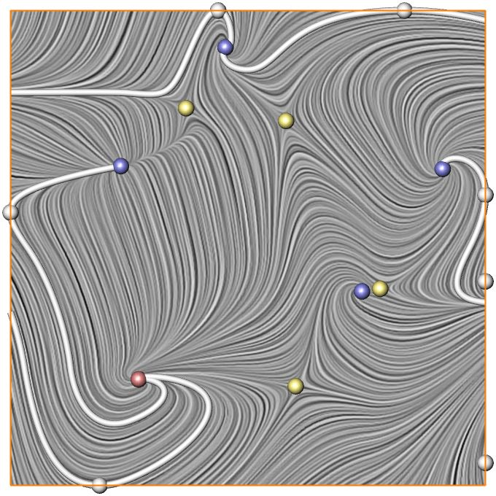
Topological Structures
from the boundary

Slide 20
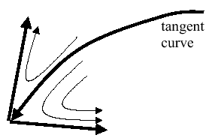

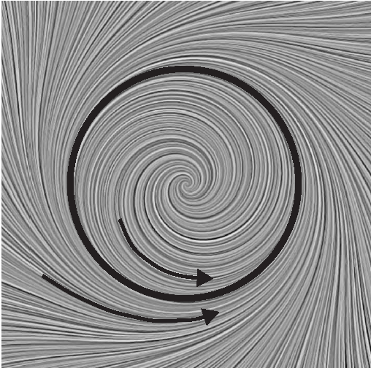
Flow Visualization: Problems and Concepts
All the three different types of separation

Slide 21
Flow Visualization: Visualization Methods
3D stationary vector field
critical points
boundary switch curves
separation surfaces
saddle connectors
boundary switch connectors

Slide 22
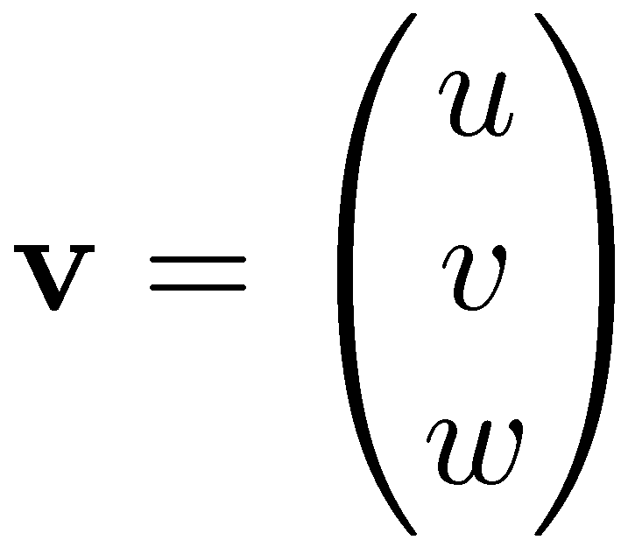
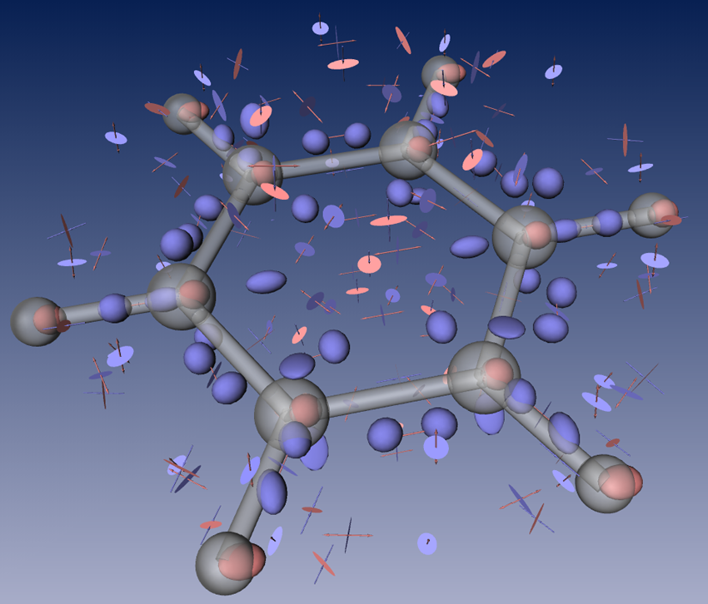
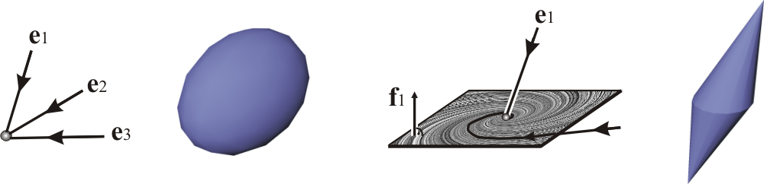
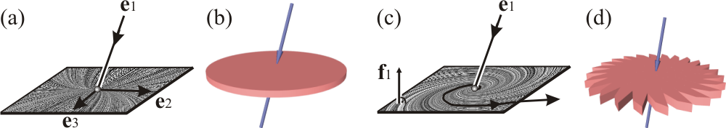
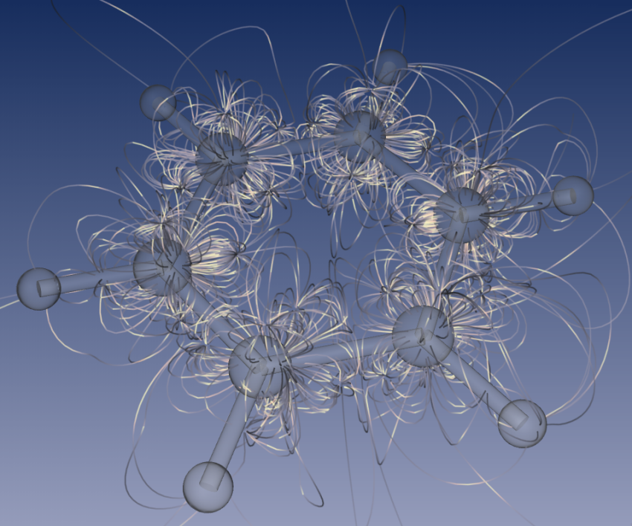
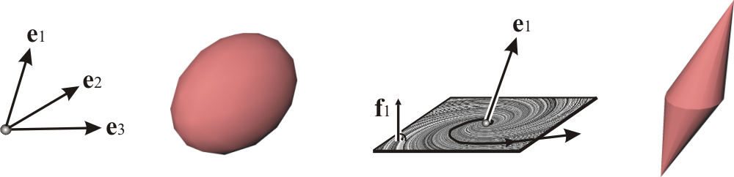
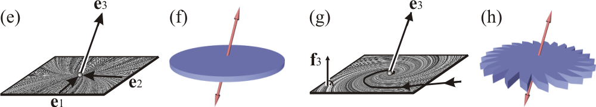
Topological Structures
steady 3D vector field
stream lines
critical points
sources and sinks
repelling and attracting saddles

Slide 23
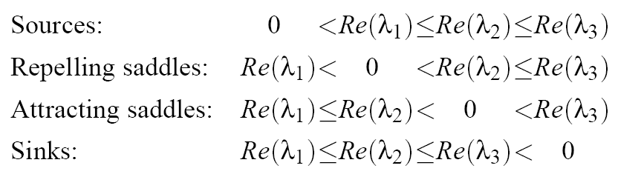
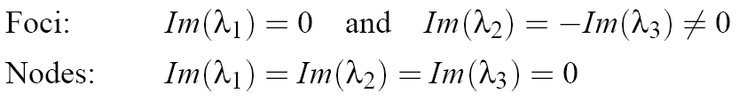
3D Topology: Critical Points
Classification by an eigenvalue/eigenvector analysis of Jacobian matrix
Outflow / Inflow behavior
Repelling Parts
(Outflow)
(Inflow)
Attracting Parts
Focus (Swirling) / Node behavior

Slide 24
Flow Visualization: Problems and Concepts
node
focus
source
sink

Slide 25
Flow Visualization: Problems and Concepts
node
focus
repelling saddle

Slide 26
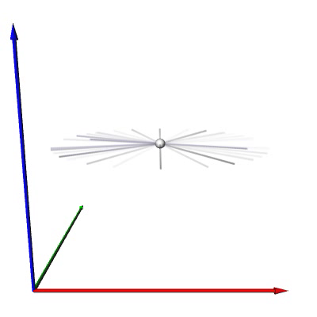
Flow Visualization: Problems and Concepts
node
focus
repelling saddle
outflow plane

Slide 27
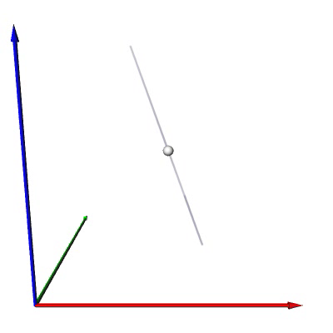
Flow Visualization: Problems and Concepts
node
focus
inflow direction
repelling saddle
outflow plane

Slide 28
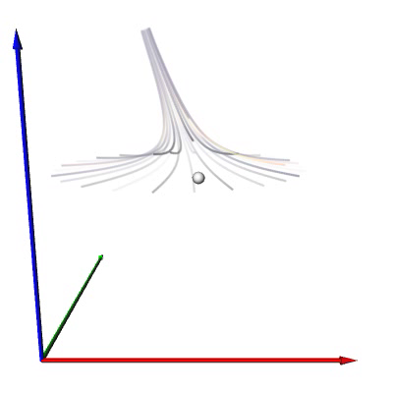
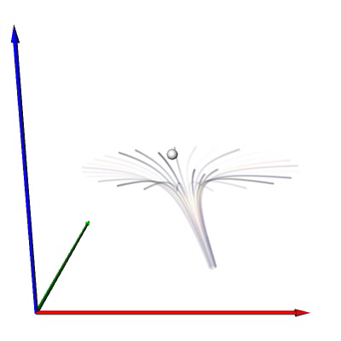
Flow Visualization: Problems and Concepts
node
focus
inflow direction
repelling saddle
outflow plane

Slide 29
Flow Visualization: Problems and Concepts
node
focus
attracting saddle

Slide 30
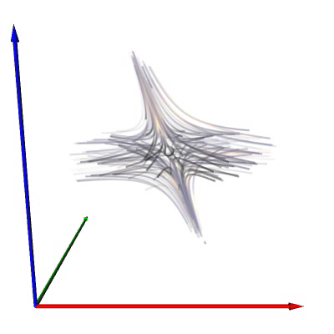
Segmentation around Critical Point
Area around critical point
Sectors of different flow behavior

Slide 31
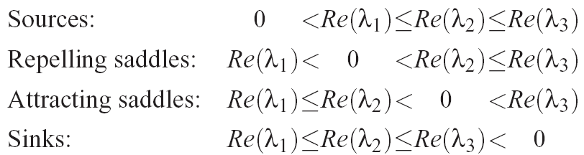
Flow Visualization: Problems and Concepts
Index of first order critical points:
Index:
1
-1
1
-1

Slide 32
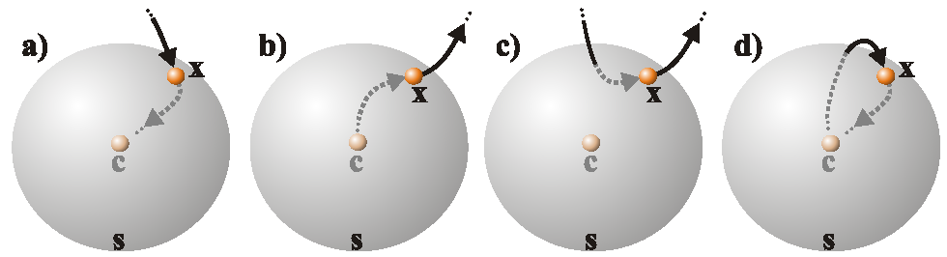
Flow Visualization: Problems and Concepts
general critical points:
place small sphere around point
classify inflow/outflow behavior of each point on the sphere -> segments of similar behavior
x is: a) part of inflow sector, b) part of outflow sector, c) part of hyperbolic sector, d) part of elliptic sector.

Slide 33
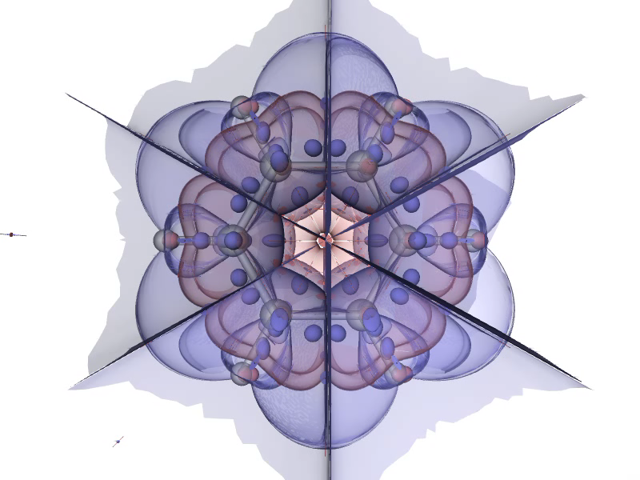
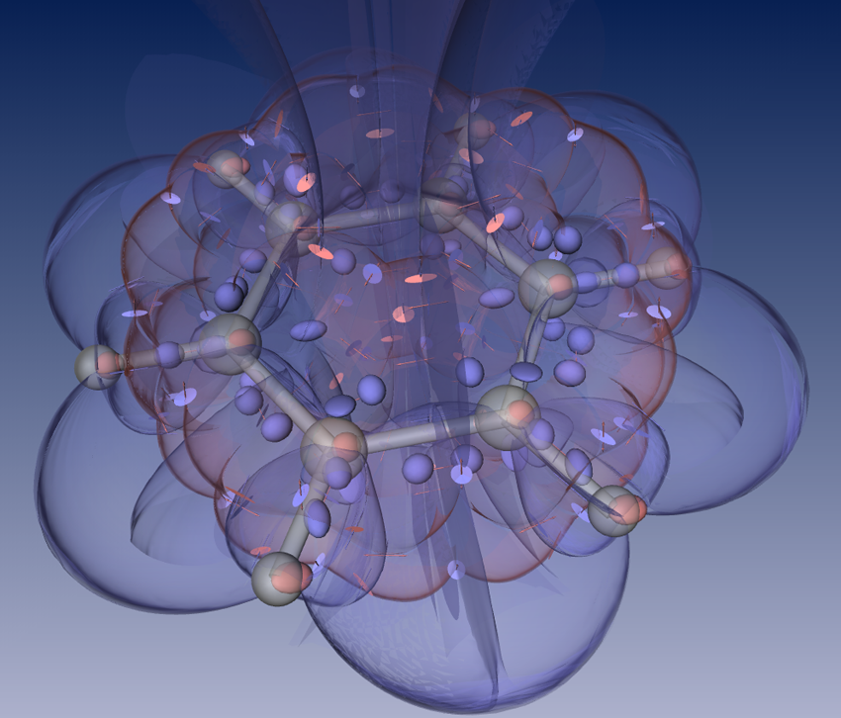
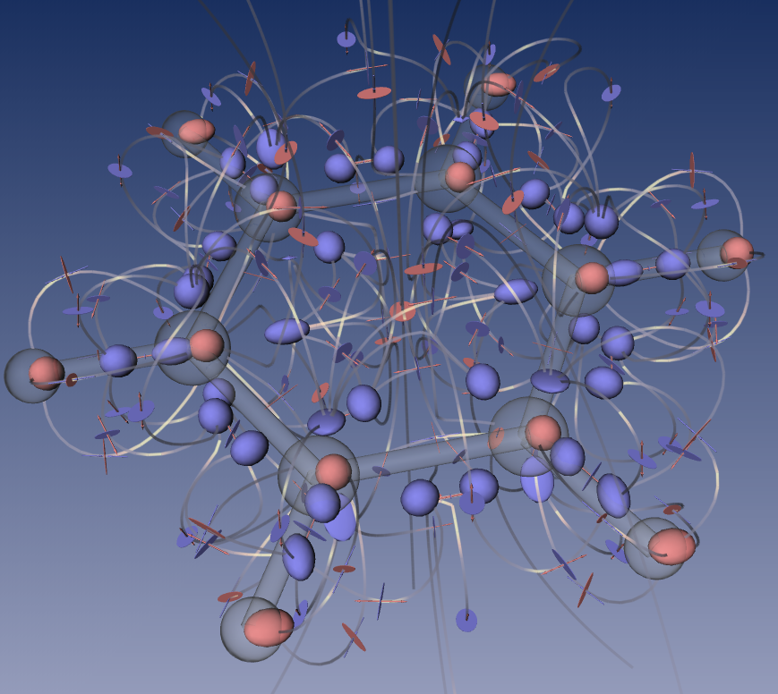
Topological Structures
steady 3D vector field
stream lines
critical points
separation lines
separation surfaces

Slide 34
Flow Visualization: Problems and Concepts
Separatrices:
stream lines and stream surfaces separating areas of different flow behavior
starting from saddle points:
stream surface starting in the inflow/outflow plane
stream lines starting in the inflow/outflow directions
starting from inbound sectors of boundary switch curves

Slide 35
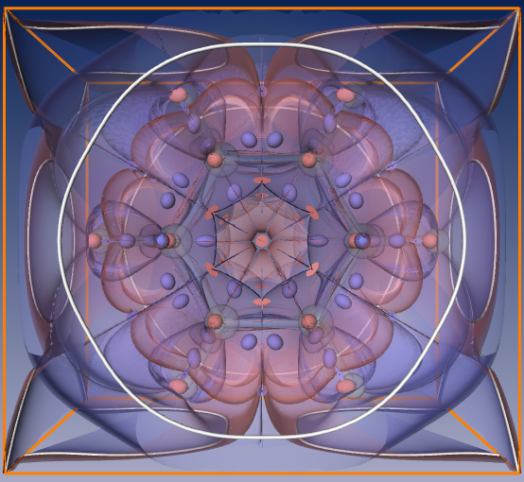
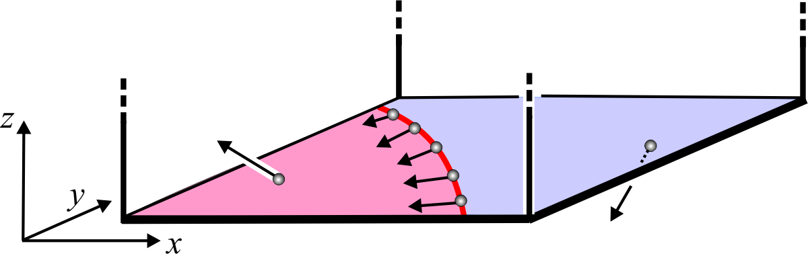
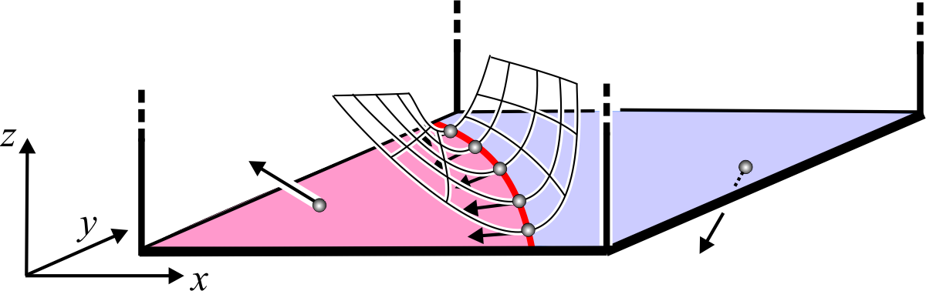
Topological Structures
from the boundary
2D
3D
Repelling
separation surface
Attracting
separation surface

Slide 36
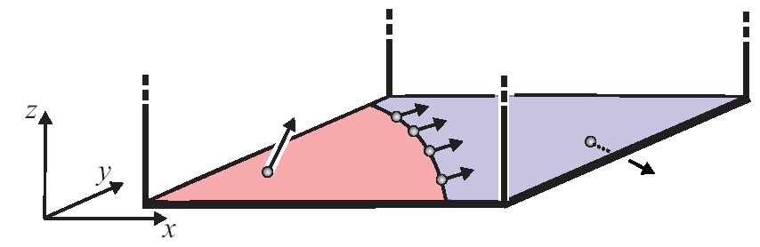
Flow Visualization: Problems and Concepts
Boundary switch curves:
segment areas of inflow/outflow at boundary of 3D domain
consist of all points x with v(x) parallel to the tangent plane of the domain boundary

Slide 37
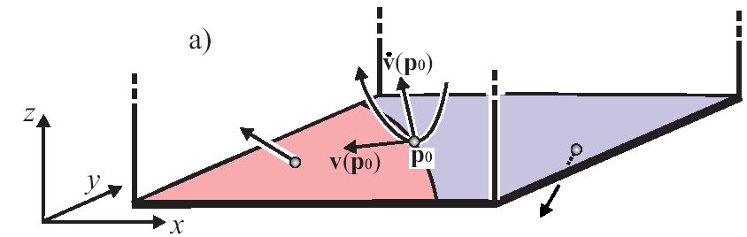
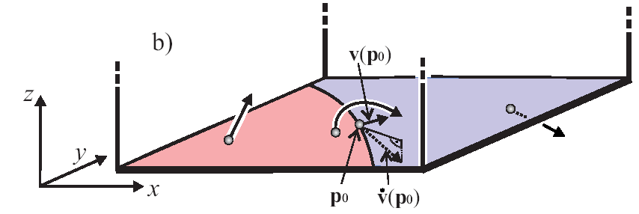
Flow Visualization: Problems and Concepts
Classification of boundary switch curves:
p₀ on boundary switch curve is inbound point if stream line integration of v starting in p₀ goes inside the domain
otherwise outbound point
inbound point
outbound point

Slide 38
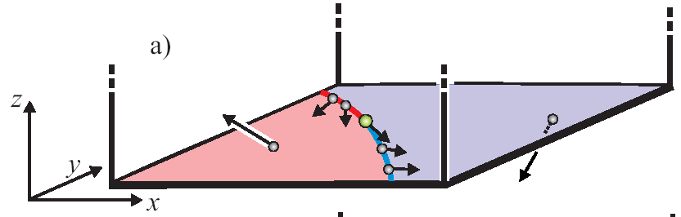
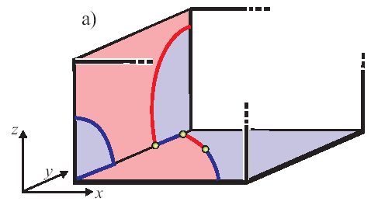
Flow Visualization: Problems and Concepts
inout point
Classification of boundary switch curves:
inout point: separates inbound sectors and outbound sectors
x is inout point if v(x) parallel to tangent vector of boundary switch curve

Slide 39
Topological Structures
Separation surfaces from the boundary

Slide 40
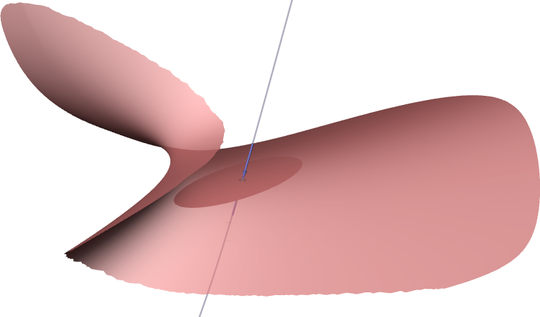
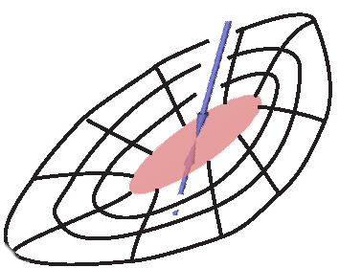
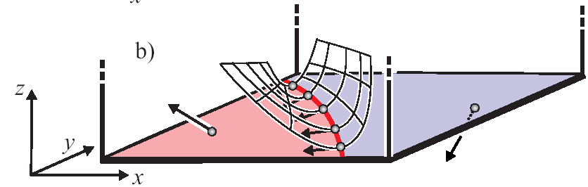
Flow Visualization: Problems and Concepts
Separatrices:

Slide 41
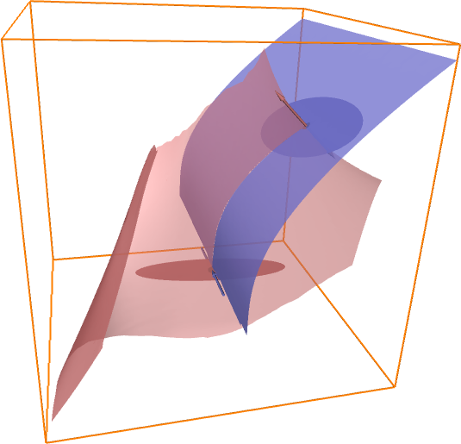
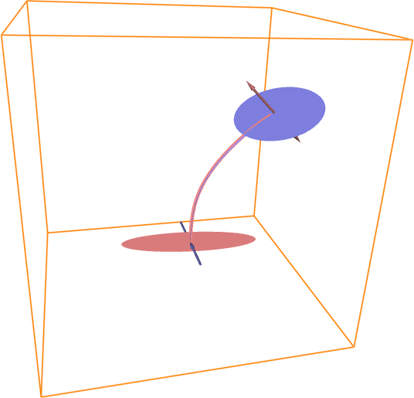
Topological Structures
saddle connectors
stream line connecting a repelling with an attracting saddle
stable structure

Slide 42

Topological Structures
saddle connectors

Slide 43


Flow Visualization: Problems and Concepts
Boundary switch connectors:
intersections of separating surfaces from boundary switch curves

Slide 44



Topological Structures
boundary switch connectors

Slide 45

Topological Structures
unsteady vector field

